Slide 1
How Do Nonrenewable Price Movements Affect Consumer Energy Costs?
Jared Andreatta

Slide 2
Introduction
Special Index for Energy
Composite measure of household energy index and motor fuels index. ^{[1]}
Household Energy Index: measures price movements of commodities used for residential energy purposes (i.e. heating/cooling, cooking, electricity, etc.).
Motor Fuels Index: measures price movements of commodities used for fossil fuel-based motor vehicles.
Index is U.S. Specific, not global.
Indexes end-use consumer energy costs.
Motivation
CPI is an important metric to measure economic health and cost of living/doing business.
Serves as a market indicator for the nonrenewable energy sector.
Magnitude of effect estimates can be used for producers (strategic business decisions) and consumers (budget planning).
[1] Bureau of Labor Statistics Consumer Price Index

Slide 3
Data and Methodology
FRED, Yahoo Finance, EIA, US BLS CPI, US BLS PPI.
Target and Regressors
Nominal monthly price index (Index 2024 = 100)
Econ Controls
effr_change and cpi_change
Nominal monthly change (% change)
dxy (US dollar index)
Nominal monthly index (Index 2024 =100)
Energy Control
ren_cons_res (residential renewable consumption)
Monthly US renewable consumption (trillions BTUs)
Target | Regressors | Econ Controls | Energy Control
energy_index | ppi_coal | effr_change | ren_cons_res
 | ppi_crude | cpi_change
 | ppi_nat_gas | dxy
 | ppi_gasoline
 | ppi_diesel
 | ppi_heat_oil

Slide 4
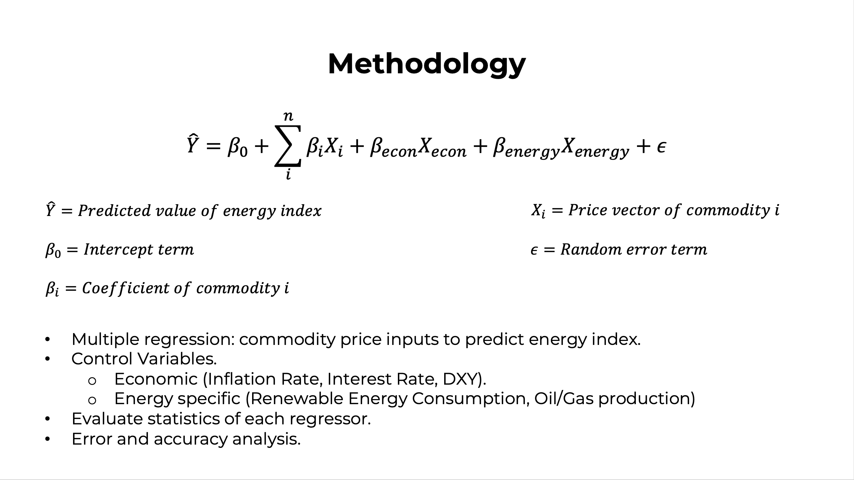

Slide 5
How Do Commodity Price Movements Affect Consumer Energy Costs?
Jared Andreatta

